Slide 1
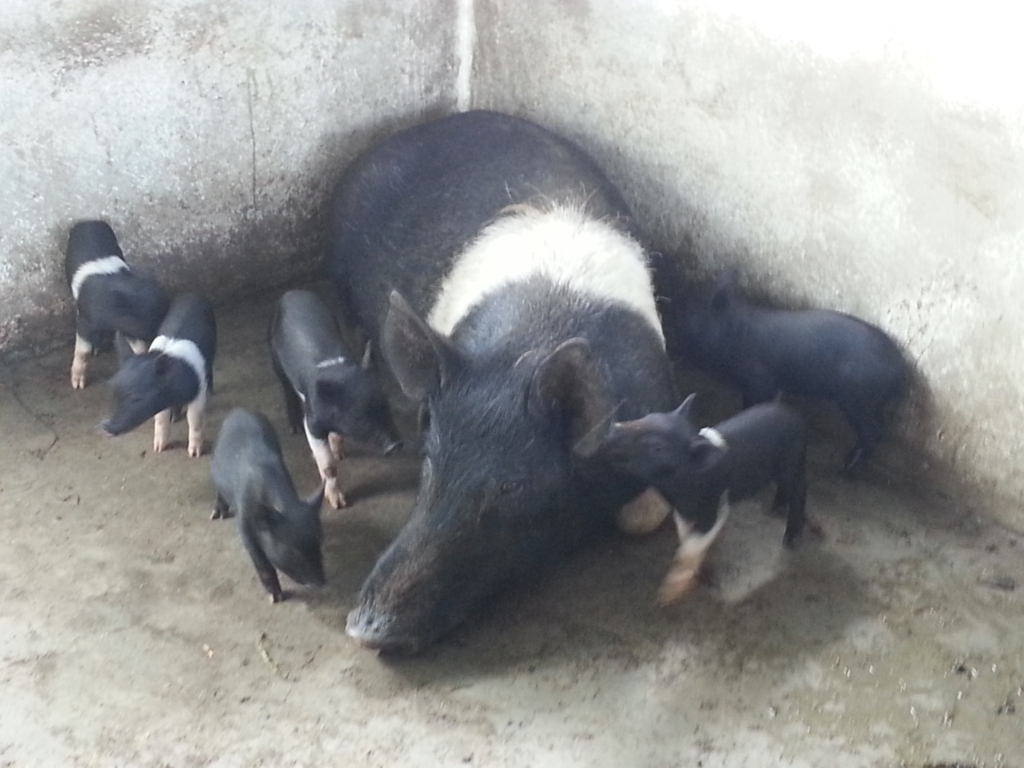
PIG FARMING

Slide 2
PIG FARMING
(A Piggy Bank)
Livestock sector has been among the fast growing sectors in rural areas, that is extremely livelihood intensive, self employment and highly remunerative for our farmers.

Slide 3
The people of the North East are generally non-vegetarian due to their tradition, culture and climatic condition and Arunachal is no exception. As such, the demand of piglets and pork is very high but the present availability is inadequate to meet the high demand of local population of this District

Slide 4
In fact, this sector could be very basis of improved diets and is vital in the socio-economy upliftment of the district. Therefore, it is imperative to encourage and promote sustainable and livelihood generating activities such as pig rearing.

Slide 5
Advantage of pig farming
1. Pigs can be reared according to own will in small or large numbers, and can increase or decrease the stock.
2. Multiple farrowing: Pig gives many piglets at one farrowing and hence, production can be multiplied rapidly.
3. Pigs grow much faster comparing to other animals.

Slide 6
4. It is efficient way of producing meat (pork), and with it, protein requirement in human can be meet. Indian Medical Council has advocated that the optimum animal protein requirement is 15g/day/individual, but now, consumed protein is only 6.03g.
5. It is adapted to specialized and diversified type of farming.
6. Pig farming does not require expensive housing and equipments.
7. Labour requirement is less comparing to other livestock enterprises.
8. Quick returns of income.

Slide 7
9. Pigs and breeding stock are readily available.
10. Feed efficiency is higher than any other livestock.
11. Pigs have ability to pick up edible grains.
12. pigs can utilized those grains unfit for human consumption, and therefore, provides satisfactory marketing of those grains

Slide 8
Disadvantage: -
Vegetarians and some other person do not take pork.

Slide 9
System of Pig farming
1. Open range system: Animals remain free and not in confinement. Feeding is lesser, labour lowered as animals roaming freely and collecting their feed. However, large space is requiring in this system.
2. Confined system: Animals are kept confined. Growth rate of pig is better and breeding can be done according to own choice in this system, but requires more labour and care as animals are kept confined.
3. Scavenging system: The animals are roaming freely, and use night soil, garbage etc.

Slide 10
Selection of site for farming
1. Pig farm should be in dry and elevated land area.
2. Farm should be well connected with motorable road, but should not be in busy street.
3. Away from human habitation, but nearer to market place where farm product can be easily disposed.
4. Veterinary Dispensary nearby.

Slide 11
5. Farm should be located away from heavy industry to avoid pollution.
6. Farm should have good sources of water supply, electricity provision, and medical facility nearby.
7. Have provision for procuring cheap labour.
8. Farm should have sufficient land area for utilizing farm source, housing, disposal of faeces, storage of feed etc.

Slide 12
Factors to be considered in selection of breed
1. Availability of breeding stock in nearby area.
2. Prolificness: Ability to grow and multiply.
3. Growth ability: some breed grows faster than others.
4. Temperaments: Animal with good temperament should be selected for easy handling.
5. Efficient use of feed: Some animals have high feed efficiency than others.
6. Carcass utility: Animal with high lean meat with low fat content is better.

Slide 13
7. Nicking ability: Breed differs in ability to nourish and large litter of piglets, and able to produce heavier pigs at weaning.
8. Market demand: Breed so selected should have good market demand. In some place, black pigs are demand for pork.
9. Disease resistant: Breed with more disease resistant power be selected.
10. Adaptability: Breed should be such that have ability to perform in different environment.
11. Personnel like and dislike.

Slide 14
Factors to be considered for profitable swine production
a. Open range system -
i. Use of good breeding stock.
ii. Proper management of breeding herd.
iii. Proper feeding and management of during gestation period.
iv. Proper feeding of sow and litter during and after farrowing.
v. Iron injection to be given on 4th & 14th day of birth of piglet to prevent piglet anaemia.

Slide 15
b. Confined system –
i. Provide adequate legume pasture.
ii. Maintain efficient feeding and water equipments.
iii. Feed adequate ration.
iv. Provide satisfactory housing.

Slide 16
Ration for Pig:
Ingredients –
i. Maize crush – rich in carbohydrate, used for energy.
ii. GNC – rich in protein, brown colour.
iii. Wheat bran – carbohydrate, more white & rough than rice polish.
iv. Fish meal - protein.
v. Rice polish – carbohydrate.
vi. MOC – almost brown color.
vii. TOC ( Til Oil Cake ) – Black color.
viii. Bone meal – protein.

Slide 17
Composition of ration for swine:
Sl.No | Feed Ingredient | Starter/creep | Grower | Finisher
1. | Maize | 60% | 50% | 35%
2. | G.N.C | 20% | 20% | 20%
3. | Wheat bran | 9% | 22% | 37%
4. | Fish meal | 8% | 5% | 5%
5. | Mineral mixture | 2.5% | 2.5% | 2.5%
6. | Salt | 0.5% | 0.5% | 0.5%
 | TOTAL | 100% | 100% | 100%

Slide 18
Types of ration:-
i. Starter ration/Creep ration: 1st week of age to weaning or 56 days. The ration is rich in vitamin, minerals, and is supplement of mothers’ milk. Butter milk, skimmed milk can also be used.
ii. Grower ration: Weaning to 35 Kg or 5.5 months of age.
iii. Finisher ration: Above 35 Kg or 5.5 months of age.

Slide 19
Ration is to be given twice in a day, once in a morning (9.30am) and once in afternoon(3.30 pm).
Pig weighing 70 kg and above may require 2 – 2.5 kg of ration/ day.
Advance pregnant animal & breeding boar during breeding season require energy & protein for maintaining health..

Slide 20
Feeding of pregnant sow: Flushing is to be done in case of pregnant sows. Flushing means giving extra ration containing vitamin, minerals, protein for better health to an animal prior to 2 – 3 weeks of farrowing and service. This helps mother nourishing piglets inside the uterus. Hence, mother maintaining good health secretes more milk and litter size also becomes bigger.
Non conventional feed is actually not advisable to feed, however to maintain income, it is used in finisher feed such as garbage (swill), fruit factory waste, but this should be boil to kill germs.

Slide 21
Breeds of Pig:-
A. Old established breed :
Sl.No. | Name of breed | Original place | Colour & body marking | Ear type
1. | Landrace | Denmark | White | Large & drooping
2. | Yorkshire | England | White | Erect
3. | Tamworth | England | Red | Erect
4. | Duroc | USA | Red | Drooping
5. | Hampshire | USA | Black with white belt over the chest & extending to the forelegs | Erect
6. | Chesterwhite | USA | White | Drooping
7. | Berkshire | UK | Blact with white on feet & switch | Erect
8. | Poland china | USA | Black with white on face, feet, leg & switch. | Drooping
9. | Spot | USA | Black with white spot | Drooping
10. | Saddle back | UK | Black with white belt | Erect

Slide 22
Hampshire was established in the year 1893, has excellent motherly ability, and could be used effectively for cross breeding programme

Slide 23
B. New breed: They are cross bred, established from old established breed, giving good production.
Beltsville-1 | USA | Black with white spot | Drooping
Beltsville-2 | USA | Light red | Erect
Minnesota-1 | USA | Red | Slightly erect
Minnesota-2 | USA | Black with white spot | Slightly erect
Minnesota-3 | USA | Light red with black spot | Slightly erect
Maryland | USA | Black with white spot | Erect
Montane | USA | Black | Slightly drooping
Lacombe | USA | Black | Drooping
Sam pierre | USA | Black & white | Erect
Palouse | USA | White | Slightly erect to drooping

Slide 24
Identification of animal:
Identification of the animal can be done by following method -
i. Ear notching
ii. Ear tagging
iii. Tattooing or by
iv. Branding.

Slide 25
Judging of Swine type
i. Observation of animal from a distance when it is in group.
ii. Close observation of animal to detect the defect.
iii. Make the animal walk and observe to find the defect.
iv. Pedigree record of the particular animal

Slide 26
v. Other observation includes colour, conformation, body marking, shape and size, nos. of teat etc.
- Nos of teat should be 12 – 14, if the teat is too much rudimentary then the animal may not have milk secretion ability.
- Pig should have firm and well arch back and well set ventral line.
- Should have strong pastern.
- Feet & legs should have no deformities.
- Ham should be deep, well set and firm.
- Side should be deep, firm and smooth

Slide 27
Routine and periodical job in pig farm
These jobs are essential for maintaining the farm.
a. Routine job:
i. Cleaning and disinfection of sty
ii. Feeding and watering (twice daily).
iii. Spotting out sick animals
iv. Maintenance of proper record.

Slide 28
b. Periodical job:-
weaning
ii. Vaccination
iii. Castration
iv. Cutting of needle teeth
v. ear notching
vi. putting the sows into farrowing pen
viii. Helping of farrowing sows
ix. Transfer of pigs
x. Balancing of body weight of animals, that is, litter weight at birth and at weaning.

Slide 29
Working scheduled in pig farm
a. Morning – i. Cleaning and disinfection early in the morning before feeding.
ii. Feeding & watering
iii. Spotting out the sick animal.
b.Noon = i. weaning ii. Deworming iii. Service iv. weighing v. Needle teeth cutting.
c. Evening - I. Cleaning and disinfection including disposal faeces
ii. Feeding of ration
iii. Record keeping ( Maintenane of record ).

Slide 30
RECORD KEEPING
a. Feed record – i. Date of issued
ii. Quantity issued
iii. Cost of feed
iv. Sources from which received.
b. Labour record – i. No. of labour engaged
ii. Date iii. Wage per person.
c. Farrowing register-
i. No. of litter farrowed & Date
ii. No. of litter weaned & date
iii. Name of sow

Slide 31
d. Breeding register – i. Name of pig ii. Date of service iii. Identification marks.
e. Health care & mortality record –
i. Preventive vaccine – given to prevent the epidemic form of diseases such as Swine fever, Hog cholera, FMD, Anthrax etc.
ii. Deworming – done periodically, also need feacal examination, type of medicine used to be recorded.
iii. Treatment register – date & medicine used to be recorded.
iv. Mortality register – Date of death & cause of mortality be recorded.

Slide 32
f. Herd or pedigree record - pedigree means record of ancestor up to four times generation. Each animal’s history is recorded from birth onward. Nicking ability, growth rate, performance of animal can be known with this record.
g. Overall record/ complete enterprise record.

Slide 33
CARE AND MANAGEMENT DURING AND AFTER FARROWING
1. Attendant should look after the sow and piglets.
2.Disinfection of farrowing pen before farrowing.
3. Pregnant sow should be transferred to farrowing pen 3 – 4 days before expected date of farrowing, that of is 114+3 days after service.
4. Cleaning of tongue, eyes and nostril of piglets.
5. Removal of placenta after expulsion of piglets.

Slide 34
6. After removing the placenta, the piglets should be fed as all teats may not function or piglets may not get the teat directly.
7. Runt should be put in pectoral region where more secretion of milk is there. Piglets have habit of sucking that same particular teat, and hence they do not fight for teat.
8. After complete expulsion of piglets, pessaries like Furea bolus should be inserted inside the vagina or uterus for disinfection.
9. Colostrum feeding: colostrums (first milk) which is rich in vitamin a and antibodies should be fed to every piglets as colotrum provides immunity.

Slide 35
10. Cutting of umbilical cord in first day. Apply tr. Iodine or antiseptic ointment after cutting the cord.
11. Cutting of needle teeth in second or third day with the help of tooth nipper to prevent injuries to the mother’s teat.
12. Iron injection ( Imferon ) be given 4th & 14th day to prevent piglet anaemia.
13. Copper sulfate solution or iron sulfate solution could be rub on mother’s teat, which is also essential to prevent piglet anaemia.

Slide 36
Weaning
Weaning means separation of mother from the piglets,usually done at 56 days (8 weeks) of age of piglets. However, weaning is usually done by weight but not by age. Separation of mother have got certain advantages, such as, piglets do not face new environment, although miss their mother. However, early weaning can be done at 21 days of age to obtain multiple farrowing.

Slide 37
Advantages of early weaning includes –
i. Reduce piglet mortality by preventing crushing of sow over the piglet.
ii. Rebreed can be done in shorter period.
iii. Prevent health loss of sow
iv. Save space requirement.
v. Body weight of piglet is better at mature and
vi. Prevent transmission of disease and parasite from mother to piglets.

Slide 38
Disadvantages of early weaning –
i. Cost of raising piglets is high.
ii. Skill labour is required.
iii.Milk replacer is require (Egg yolk+Glucose+water+antibiotic)
iv. Greater devotion is essential.

Slide 39
Foster mother
In case of non-functional teat or inverted nipple in mother (Sow) or the sow died after giving birth, the foster mother is used, usually done in large farm. After rubbing the piglets with certain aromatic substances or with certain sort of antiseptic, are transferred to foster mother so as not to recognize them by smelling.

Slide 40
Cause of Mortality in piglets
Up to 80% mortality in piglet is found in pre-weaning period.
1. Trampling - Means death or crushing death. This should be taken care of by the attendant.
2. Piglet scouring – cause by Escherichia coli, usually found in faecal contamination and hence, disinfection of farrowing pen is essential.
3. Piglet anaemia – Iron injection to be given on 4th & 14th day of piglet.
4. Swine fever – vaccination in 6 – 8 weeks of age.

Slide 41
Management of Boar
i. Good ration should be given, particularly, breeding boar.
ii. Boar should be given exercise to make animal active and for better circulation, otherwise boar will become fatty and thereby loose l reproductive activities.
iii. Male/female ratio: 1:4
iv. Breeding be allowed from 12 months of age, but from 18 months - 4 yrs, fertility is high.
v. Similar size boar can be kept together, or may house individually.

Slide 42
Advantages –
i. Boar odour can be removed and thereby improve quality of pork.
Ii. Faster growth rate.
iii. Barrow can be housed together easily as they are sterile, and also can be housed with sow without any problem.
Iv. Housing requirement can be minimized’
v. Castrated boar becomes more docile and easier to handle.
vi. More deposition of fat in body tissues.

Slide 43
Housing for Pig
‘Build your own farm building’.
Ground Floor plan (Dry stock)

Slide 44
Floor space requirement
- Fattening pig: 10-16 sq.ft/pig
- Fattening pig in yard: 30-40 sq.ft/pig
- Farrowing pig: 60-80 sq.ft/sow & litter
- Boar pen: 40-50 sq.ft/pig
- Creep area: 15 – 20 sq.ft.
2. Wall: Height of wall should be 4’-5’ from the floor. Bricks and concrete are best material for wall. Height of 3’ from floor may be constructed with bricks / concrete, while remaining 1’-2’ may be of wood or 2’’ G.I pipe.
3. Door: wide 2’6’’ – 3’.

Slide 45
4. Trough: 12’’ space is require for each pig. Height: 12’’ and width:15’’.
5. Drain: Floor should be laid to fall toward a drain for rapid drainage.
6. Farrowing pen: Guard rail consisting of G.I pipe of 2’’ diameter or bamboo pole may be placed along the wall. Rail usually fitted 8-10’’ from and off the wall and floor.

Slide 46
Service
In pig, heat last for 2 – 3 days and service is done in late heat or second day of heat as is most suitable period. Oestrus cycle is 21 days. Heat symptom – restlessness, try to mount over other animal or mounted by others, swelling of vulva, mucous discharge, and allow the hand to place over loin region and not running away.

Slide 47
Synchronization
Synchronization means giving of some hormonal injection which makes all the animals to come in oestrous at same time.
Advantages – i. Availability of foster ii. Reduce labour works iii. Could be mated at same time iv. Marketing is also advantage v. weaning can be done at same time and vi. Loss during pre-weaning is loss.

Slide 48
ARTIFICIAL INSEMINATION
A.I means process of collection of semen, processed and deposited into the female genital tract artificially when the female is in heat. Advantages – i. Large No. of sows can be inseminated by using single boar and ii. Cost of maintenance is reduced by rearing single boar in place of many.

Slide 49
Testing of Boar for fertility: - 3 methods-
i. Microscopic examination – Motility of semen can be examined in microscope. Zigzag movement of semen indicates good fertility.
ii. Mating with 3 – 4 market gilts: After 21 days if gilt do not return to heat indicates boar fertility.
iii. After 21 days of mating, market gilt is slaughter and count for the embryos; and 10 – 12 embryos indicates high fertility.

Slide 50
System of breeding:-
Pure breeding: It can be defined as a member of the breed which posses a common ancestry breed and distinct characteristics;
e.g pure breed boar x pure breed sow/gilt. These animals may be either registered or eligible for registration in that breed. The objective of pure breeding is to supply pure breed animal for breeding purpose to other farmer’s enterprise.

Slide 51
ii. Inbreeding or close breeding: The animals are mated among closely related. The objective of inbreeding is to preserve the outstanding characteristic of parent like uniform size, conformation etc., e.g. Full brother x full sister. X1 x Y1
X2xY2
Disadvantage – too much inbreeding cause still births, cleft palate. blindness, atresia anii due to lethal gene.

Slide 52
iii. Line breeding: It is less intensive form of inbreeding, not as close as date of inbreeding, e.g Half brother x half sister. The objective of line breeding is to keep offspring closely related at some highly admire ancestor.
X1 x Y1: X1 x Z1
X2,Y2 X2,Z2
X2 x Z2

Slide 53
iii. Out crossing: It is the system of breeding within the breed where the members of breed have no relationship atleast from 4th – 6th generation. This system is mostly followed by the farmers for commercial purposes.

Slide 54
Up-grading
It is a system of mating between pure breed sire with non-descriptive female. The objective is to improve the quality and productivity of local pigs. They have better adaptability and resistant power.

Slide 55
Cross breeding
It is mating between 2 or more different breeds, mainly use for commercial purpose. Different method of cross breeding –
i. Single breeding: cross between one established breed with other e.g Mulefoot x Poland china (50 x 50).
ii. Double crossing: A 75 x C 25 (where Male A x Female B=C)
A x B
C x A

Slide 56
iii. Triple crossing: A x D ( 87:13), Where, Male A x Female B=C, Male A x Female C=D
iv. Criss crossing: criss crossing between two breeds. E.g Duroc x Chester white
a x b
a x c
d x b
Criss crossing

Slide 57
v. Rotational crossing: It is mating in rotational among four or more breeds.

Slide 58
Homozygocity = Inbreeding
Repeated inbreeding lead to lethal effect of gene and animal having homozygous gene is called homozygocity. Example of lethal effect of gene includes cryptorchid, clept palate, still birth, atresia anii, and hydrocephalus etc.

Slide 59
Heterozygous = cross breeding
In case of cross breeding, there is heterozygous as one used different breeds. One gets better carcass length and desire animal in cross breeding and is practiced in commercial farm.

Slide 60
Certified litter
Atleast 2 or more piglets must be raised to 320 lb body weight in case of sow’s litter, and 275 lb in case of gilt’s litter at 56 days; plus two pigs must be slaughtered at 180 days, the pig should have 220 lb and should have minimum carcass size of 29.5” and minimum loin area of 4.58 sq.inch.
Certified sire
Any boar/sire, 5 certified litters from 5 different sows is called certified sire.

Slide 61
Vaccination
Iron injection on 4th and 14th day of piglets
Swine fever vaccination on 6 – 8 weeks of age (1ml i/m).

Slide 62
PERPORMANCE OF HAMPSHIRE AT 30 SOWS UNIT, C.V.Sc., Khanapara:-
i. Average age at first maturity: 222days
ii. Average age at first conception: 265 days
iii. Average litter size at birth: 9.1 kg
iv. Average litter size at weaning: 7.6 kg
v. Average individual weight at birth: 1.7 kg
vi. Average individual weight at weaning: 11 kg
vii. Average individual weight at 7 months: 66 kg
viii. Feeding conversion efficiency (weaning to 8 months of age): 1:3:89 kg
ix. Cost of production/kg live weight (plus labour cost): Rs. 9.5.

Slide 63
Terms in piggery:-
Piglet/pigling: Young animal of pig of either sex.
Boar: Adult male pig use for breeding.
Sow: Adult female pig which has already farrowed.
Hog/barrow: Castrated male pig.
Gilt: Female pig which has not yet farrowed.
(Open gilt-not serve/pregnant; Closed gilt- Served and conceived)
Runt: Smallest piglet of litter.
Litter: Nos. of young one born at a time; bedding for pig is also called litter.
Ranting: Biting of teeth, usually practiced by young boar.

Slide 64
Pig belongs to:-
Kingdom – Animal
Phylum – Chordata
Class - Mammalia
Order – Artiodactyla
Family – Suidae
Genus – Sus
Species – Sus scrofa, Sus vittatus, Sus domestic.

Slide 65
Reference books:-
1. Swine production - Bundy Diggins & Christensons.
2. Swine production – Krider & carrol.
3. Pig production – James & Cole.
4. Pigs – Reid.

Slide 66
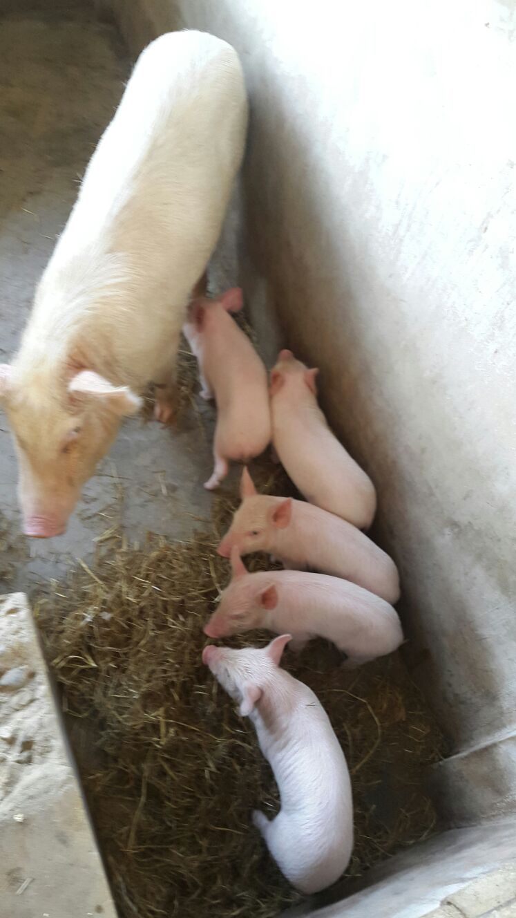

Slide 67
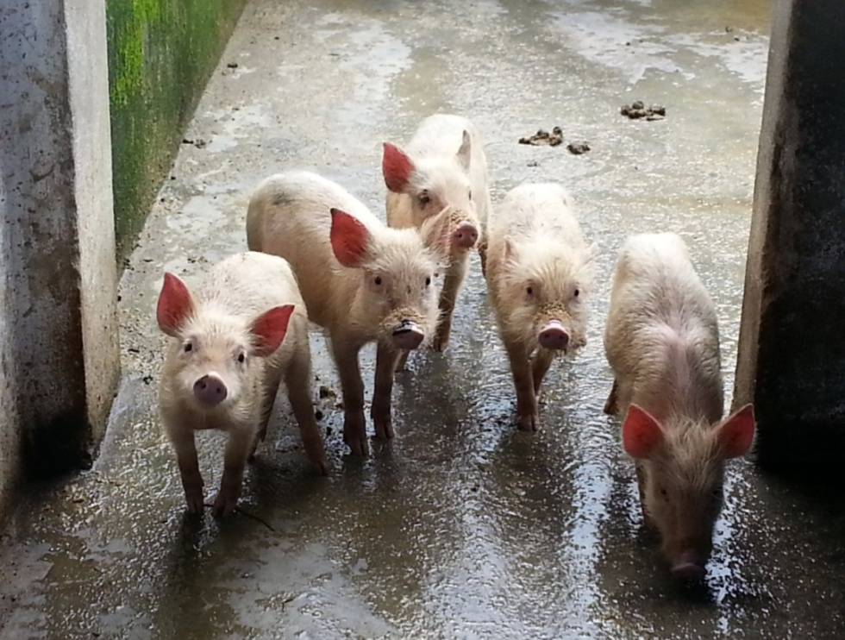

Slide 68
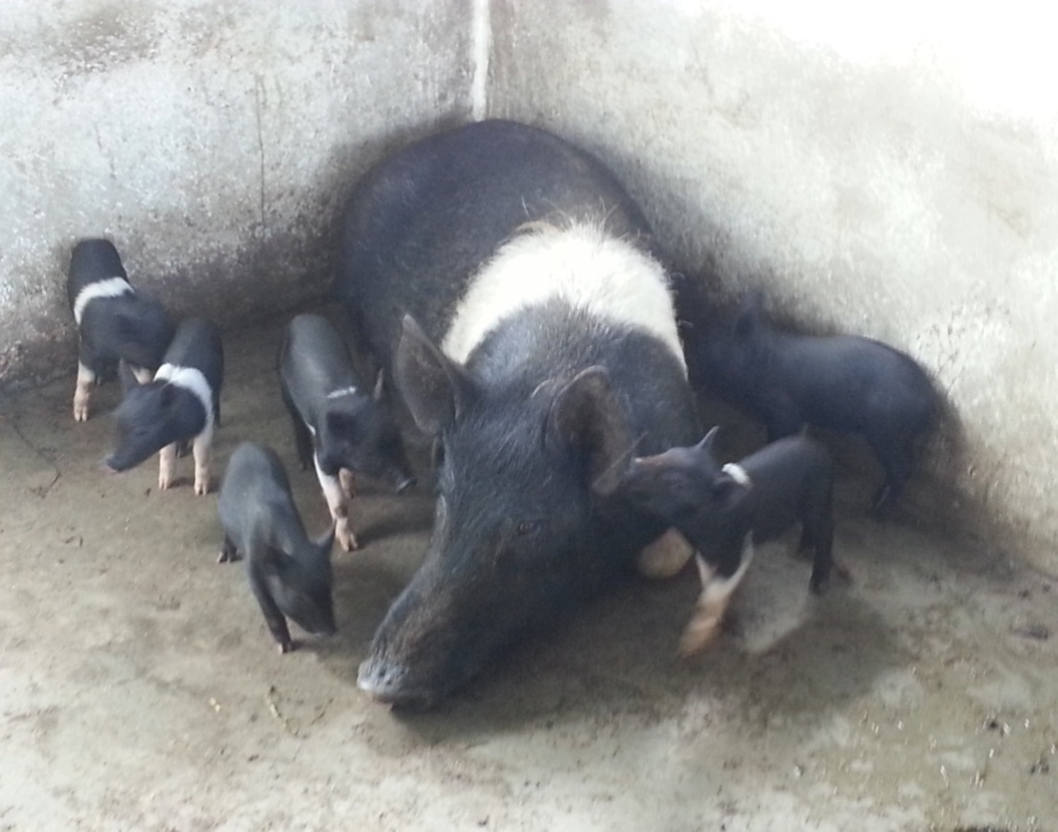
Thank You

